Slide 1
Module V - Practical Data Science Session
SMEs, Algorithms, & Modeling Basics
Open-Source Libraries & Packages
GPUs & Improving Data Science Workflow
Notes:
Original Goal: Provide insights into the complexity involved in Data Science, particularly the types of decisions that must be made and the consequences of those choices.

Slide 2
Practical Data Science Session
Algorithm & Modeling Basics
This intro course is not dedicated to Machine Learning, but basic algorithm and model development is one of the most enticing aspects of Data Science.
This first part of the Practical Data Science Session will cover the basic aspects of algorithm/model development including communication with Subject Matter Experts, Algorithm Scoring, Modeling, and Tuning. Although much of this won’t be covered in Python code (as it will be in future courses), this provides background context for remaining course material.
Notes:
Remember, it is highly unlikely that you will be responsible for the entire process from end-to-end. Your focus is on developing models and outputs that are usable and accurate, and using the appropriate tools to accomplish that goal.

Slide 3
Subject Matter Experts
On the job, you will be developing models for a client for a specific purpose. This client either is or retains Subject Matter Experts (SMEs) on the topic your model will apply to.
Notes:
They can answer EDA-based questions, provide insight, clarify what is needed. You know the models, they know the data.

Slide 4
Subject Matter Experts
Most decisions you make -- from EDA to Cleaning/Processing to Algorithm Scoring -- will be directly impacted by the preferences and needs of the client and the knowledge provided by SMEs.

Slide 5
Utilizing Subject Matter Experts Data Cleaning Example
Joining Classes
'Administrative' Group
ADMINISTRATIVE
MESSAGE - SOF/ASAM
Returned for Recap/Reset
Returned for Upgrade
RETURNED FOR A/C RETIREMENT
'Time-Based' Group
REMOVED FOR TIME CHANGE
REMOVED FOR TIME CHANGE - SCHEDULED MAINTENANCE
OVERHAUL REQUIRED DUE TO LONG-TERM STORAGE
'Maintenance-Related Issue' Group
HANDLING DAMAGE
MAINTENANCE DAMAGE
MAINTENANCE INDUCED FAILURE
INCORRECT PART INSTALLED
A dataset may have a label column with far too many classes (or values) for a model to accurately predict.
With SME assistance, we were able to join minor (smaller; less frequent) classes into a grouped hierarchy based on similarity.
This reduced the number of classes in the label column from >50 classes to 14.
Notes:
This is important because it reduced the noise and confusion the model has to go through to make appropriate class predictions while also creating groups that would be relevant and understandable to the SMEs and clients who would maintain the model later.

Slide 6
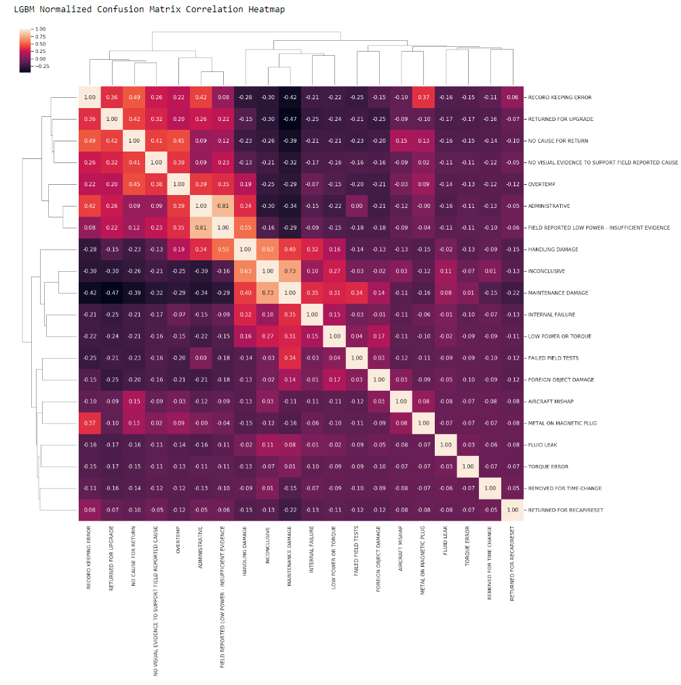
Utilizing Subject Matter Experts Algorithm Analysis Example
Understanding Consequences of Misclassification
The figure is of a Correlation Heatmap built from a Multi-Class Confusion Matrix model output.
Review of this graphic enabled us to identify which classes were being misclassified and what they were being misclassified as.
In turn, we were able to bring these findings to SMEs who were able to inform us as to whether it makes sense for the model to confuse these classes.
Classes 1-14
Classes 1-14

Slide 7
Utilizing Subject Matter Experts Algorithm Analysis Example - Zooming In
Understanding Consequences of Misclassification
Zooming In: This group of classes is frequently misclassified as each other; but this seems reasonable since each mistaken class essentially means ‘No Fault’.
However, one class is noticeably distinct from the rest (‘Real Fault’) as a frequent misclassification.
“Real Fault”
“Real Fault”

Slide 8
Utilizing Subject Matter Experts Algorithm Analysis Example - Zooming In
Understanding Consequences of Misclassification
We reached out to SMEs to ask if there were additional features to be integrated in the model to improve the ‘Real Fault’ predictions.
SMEs informed us that 95% of the time, ‘Real Fault’ was, in fact, a ‘No Fault’ classification.
This classification was used simply because it was the default issue that was reported not because ‘Real Fault’ was the true problem.
The model was performing well.
“Real Fault”
“Real Fault”

Slide 9
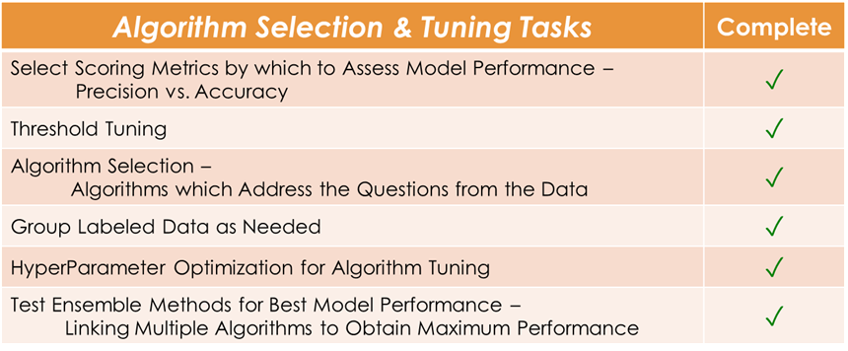
Algorithm Selection Decisions
Notes:
Each step along this process involves different decision-making that will definitively affect results of the model.

Slide 10
Algorithm Selection & Tuning Checklist
Notes:
Each step along this process involves different decision-making that will definitively affect results of the model.

Slide 11

Algorithm Score Selection
Algorithm Score Selection
In a perfect world, a model can predict with 100% accuracy.

Slide 12
Algorithm Score Selection
When perfection is not an option, a decision must be made to achieve the goal.

Slide 13
Algorithm Score Selection
With limited manpower, tell me what to search to catch something
Is the end goal to be very confident in predictions of True Positives?
Or is the end goal to be complete, to catch as many of the True Positives as possible, even though we may incorrectly label some?
We have manpower, narrow down our search, but don’t miss anything.

Slide 14
Algorithm Score Selection
Different approaches allow you to tune towards the outcome you need:
Training for accuracy (overall score) vs precision in a label (higher confidence for a particular label).
Training for ‘hit rate’: Of the highest N probability scores, how many were predicted correctly
Tuning the threshold for prediction. The default of 0.5 probability is not always the best cutoff for your task at hand
A thorough understanding of the ultimate goal, consequences of, and the manpower to utilize the results of the model is necessary.

Slide 15
Algorithm Selection & Tuning
Notes:
Each step along this process involves different decision-making that will definitively affect results of the model.

Slide 16
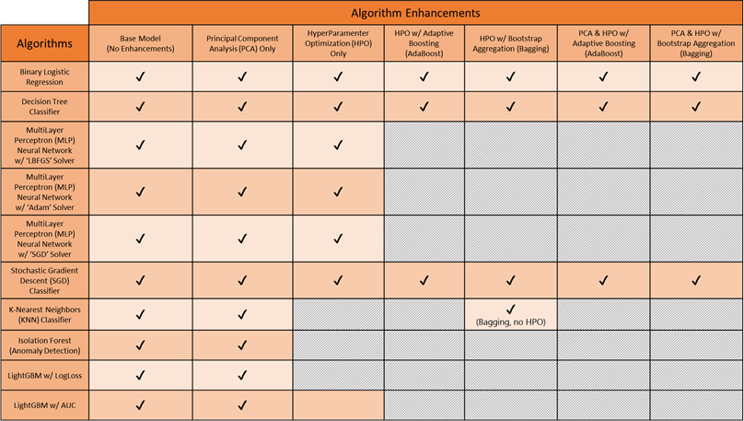
Algorithms Tested
Notes:
Throw the kitchen sink at your data! Why not? Never know what you might find!

Slide 17
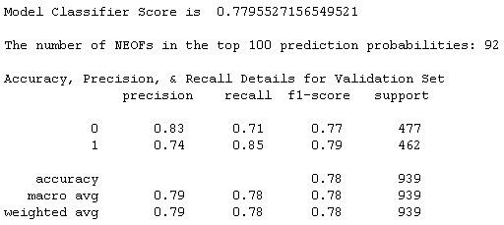
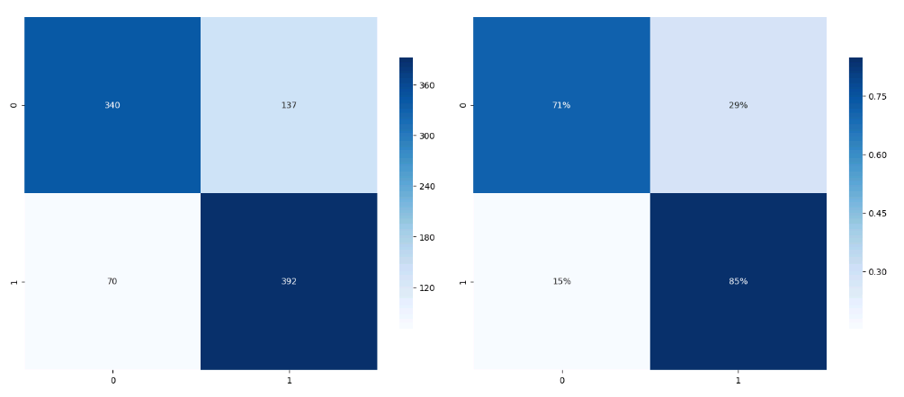
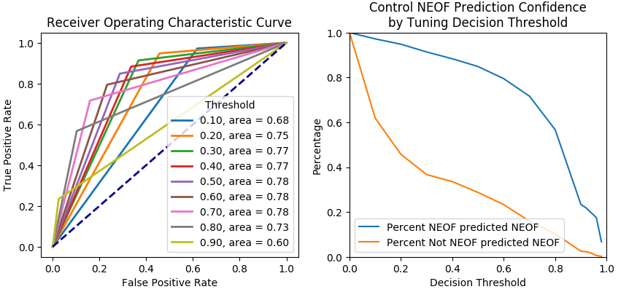
How to Select the Best Algorithm?
Percent 1 predicted 0
Percent 0 predicted 1
Notes:
Binary Class

Slide 18
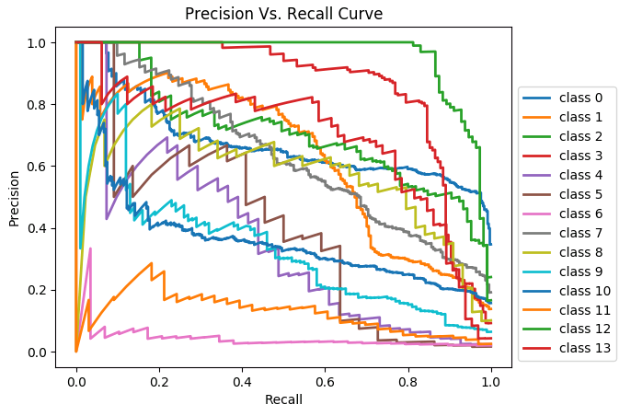
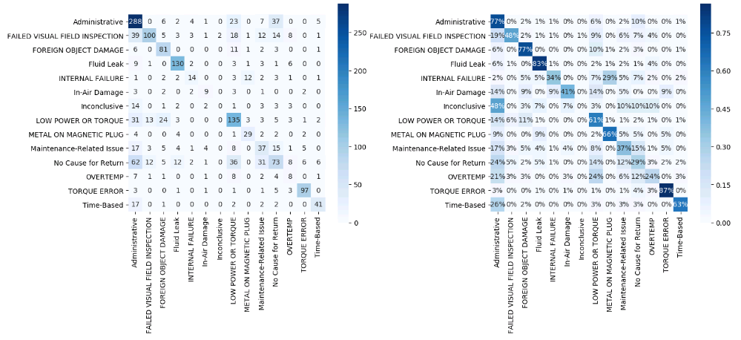
How to Select the Best Algorithm?
Evaluate as many metrics as possible for an algorithm.
Classes 1-14
Classes 1-14
Classes 1-14
Classes 1-14
Notes:
Multiclass

Slide 19
Algorithm Selection & Tuning
Notes:
Each step along this process involves different decision-making that will definitively affect results of the model.

Slide 20
HyperParameter Optimization (HPO)
What are HyperParameters? Sounds fake to me.
It is a parameter that is used to control how the model learns while a normal parameter represents the model’s learned output.
In other words, HPO is model tuning.
Through this type of optimization, a model’s speed, accuracy, and precision can be increased significantly.
Testing all possible combinations of each parameter for each model is impossible within a typical project timeline.

Slide 21
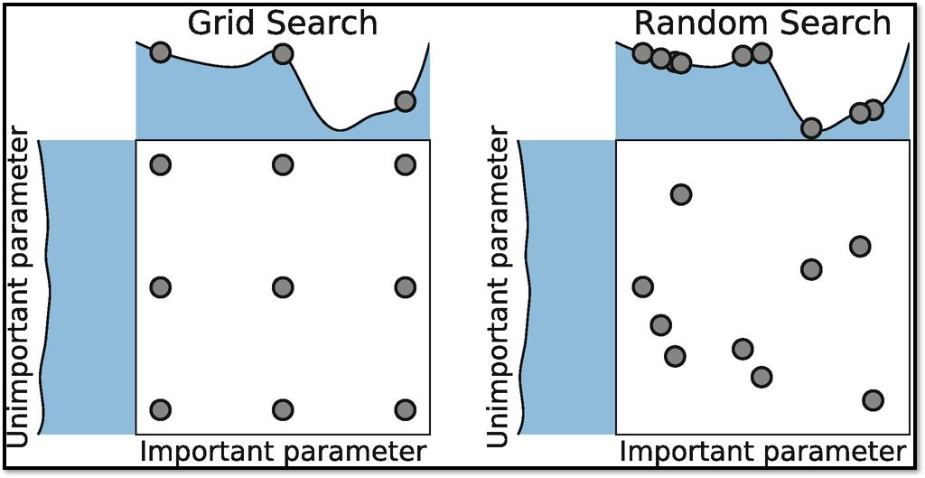
HyperParameter Optimization (HPO)
HPO is designed to find the values for each parameter in the model that will maximize model performance.
Using the Validation Set, the model is run across the parameter set (the range to be tested for each parameter is determined by user) and the parameter values corresponding to the best performing model is selected.

Slide 22
Algorithm Selection & Tuning
Notes:
Each step along this process involves different decision-making that will definitively affect results of the model.

Slide 23
Test Ensemble Models
An ensemble of top models is our best model.
PREDICTED
Results are sorted by probability. User controls the number of containers to search
Selecting 100 yields a >50% Searching Success Rate on Test Sets
Catches 32% of known contraband containers (52/162)
n=1,162,241
NO
YES
NO
1,162,031
48
1,162,079
ACTUAL
YES
110
52
162
1,161,904
100

Slide 24
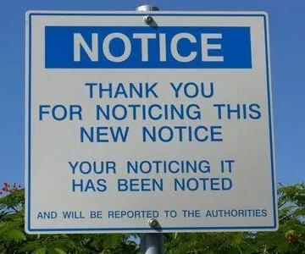
Decisions made prior to model implementation have massive impacts on the output of a model.
It is incredibly easy to miss something simple and create an ill-functioning model, despite the accuracy score.

Slide 25

The Model is Ready! ...Now what?
FULL-TRAIN THE MODEL
But I did!
Training your models in the manner we’ve described is not the same as full-training:
After final model selection, training must then be performed using the entire dataset.
No Validation/Test Split. No Cross-Fold Validation. No model metric for performance.
How do you know your model is actually working?
Field Results

Slide 26
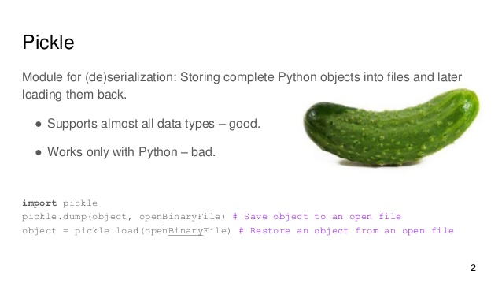
You’ve Full-Trained… Don’t Forget to Save!
After full-training, the model if finally ready for real-time data.
SAVE EVERYTHING
But, of course!
Yet saving everything references more than just your trained model:
Imputation Decisions (e.g. MICE)
Categorical Encoder
Normalization (Scaling)
Notes:
But this model is likely not going to be run by you in your virtual environment or AWS instance. It’s going to be run perhaps in an app or in a client dashboard. So you need to save all of it and pass it along. Your model pipeline actually employs multiple smaller models to thoroughly process your data. These models must be saved as well to apply your model properly on real-time data.

Slide 27
Practical Data Science Session
Open-Source Libraries
Open-Source libraries will be one of the greatest resources for conducting Data Science, right next to Stack Overflow.
Notes:
Remember, it is highly unlikely that you will be responsible for the entire process from end-to-end. Your focus is on developing models and outputs that are usable and accurate, and using the appropriate tools to accomplish that goal.

Slide 28
Libraries You’ll Use Often
Sci-Kit Learn (Sklearn)
Provides east-to-employ ML classifiers, decision trees, and base neural nets. Also provides excellent resources for data processing needs (train/test splitter, standardizer, scalers, etc.)
AdaptNLP
Developed by Novetta. One of the best libraries for using state-of-the-art NLP models within-minutes. Built on top of the HuggingFace Transformer models.
Tensorflow / Kera / PyTorch
DGL
Incredibly useful for developing graph models -- offers multiple options.

Slide 29
Module VI - Enhancing, Selling, & Delivering
GPUs / Distributed Computing / Dask
Cloud Services
Python & SQL
Modularizing Code into Scripts
Packaging Completed Work - Demos & Docker
Promoting the Work
Notes:
Original Goal: Provide insights into the complexity involved in Data Science, particularly the types of decisions that must be made and the consequences of those choices.

Slide 30
Model Pipeline May Look Something Like This
Data Decisions
Normalization
Dummy Variables for Categorical Features
Principal Component Analysis (PCA)
Unprocessed Data
Data Cleaning
Numeric Data with Different Scales must be Converted to Single Scale (e.g. height vs. weight)
Encoding for Algorithm Purposes
Method to Reduce Volume of Data w/o Losing Information
Synthetic Minority Oversampling Technique (SMOTE)
Algorithm Implementation
HyperParameter Optimization
Establishing Separate Data Sets
Model Pipeline
Output
Run Selected Algorithms & Algorithm-Specific Enhancements; Then Interpret Results
Identifies Optimal Parameters for a Particular Algorithm (To Produce Best Results)
Balancing the Data
Splitting data into Training, Validation, Full-Training, & Test Sets
Notes:
Each step along this process involves different decision-making that will definitively affect results of the model.

Slide 31
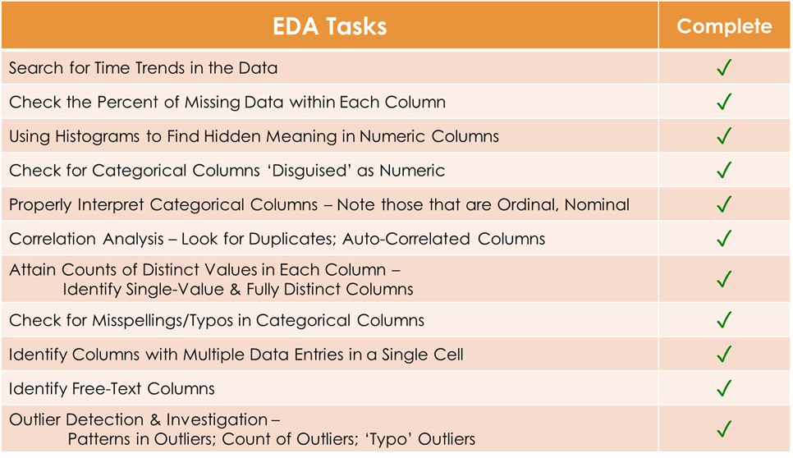
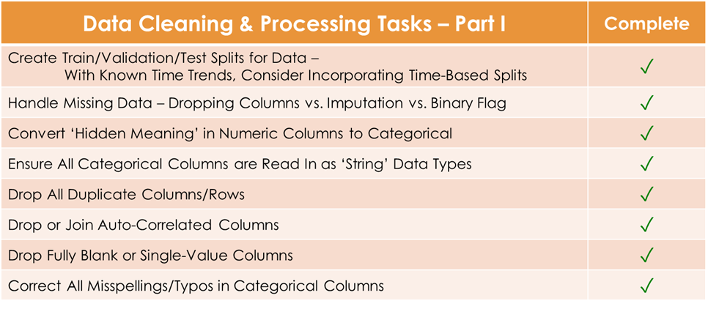
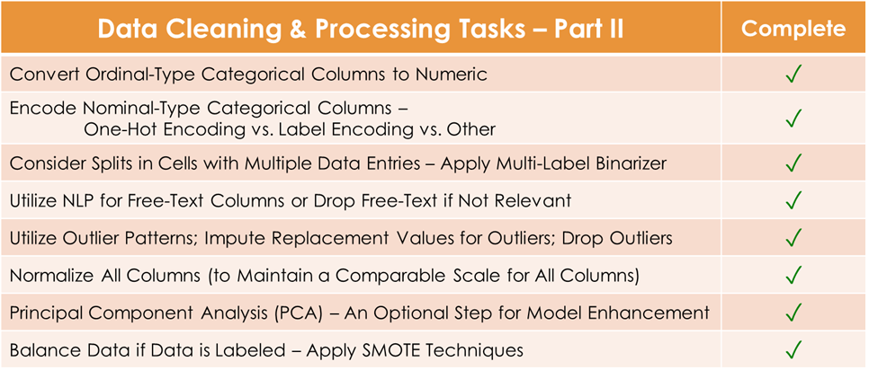
And you’ve done all this...
The Model Development Process is trial and error (often at high speeds), but must be performed with care.
Many obstacles you will encounter are not covered in textbooks.
Decisions to be made are ever-changing; These ‘task lists’ are ever-growing;
Every dataset is unique.
But there are lots of technologies, organization techniques, and soft skills that can help you make the most of a final model.

Slide 32
Enhancing, Selling, & Delivering
After you’ve trained your algorithm and developed your model process, you can’t simply hand over your work to an engineer.
The work must be packaged, either through a docker image or modularized scripts in a shared work repository or as a web application.
Notes:
Remember, it is highly unlikely that you will be responsible for the entire process from end-to-end. Your focus is on developing models and outputs that are usable and accurate, and using the appropriate tools to accomplish that goal.

Slide 33
Enhancing, Selling, & Delivering
GPUs & Distributed Computing
As datasets grow, so does the need to find more efficient ways of processing the data.
Parallelization & Distributed Computing;
Development of More Efficient Algorithms;
GPUs Becoming Widespread;
Tricks to Improve Pandas
Notes:
Remember, it is highly unlikely that you will be responsible for the entire process from end-to-end. Your focus is on developing models and outputs that are usable and accurate, and using the appropriate tools to accomplish that goal.

Slide 34
GPUs & Distributed Computing
GPUs
There are free opportunities to use GPUs.
Google Colab
NVIDIA Rapids -- https://rapids.ai/
NVIDIA cuDF, cuML
Distributed Computing
PySpark / SparkNLP
Allows you to parse and manipulate big data locally with great ease (and no GPUs!)
Dask
An open-source library for parallel computing natively in Python. Often is a default installation with Anaconda and is already deployed on most machines.
https://towardsdatascience.com/why-every-data-scientist-should-use-dask-81b2b850e15b
https://towardsdatascience.com/trying-out-dask-dataframes-in-python-for-fast-data-analysis-in-parallel-aa960c18a915

Slide 35
Enhancing, Selling, & Delivering
Cloud Services
AWS / Azure / Google Cloud
Free Student Accounts to Experiment (with GPUs)
Certifications in any cloud service is a big, showy feature on a resume (and helps earn higher pay!)
Cloud Services are expanding so expanding your own cloud skills means your at the front for cutting-edge technologies

Slide 36
Enhancing, Selling, & Delivering
Python & Additional Package Tools
Python has a highly extensible library system enabling Python programmers to utilize many other tools to improve their workflow, including packages for GPU tracking (DASK), SQL use, and for a Python-based GPU dataframe library (cuDF).
Many of these packages are popular and have easy-to-find how-to articles.
Notes:
Remember, it is highly unlikely that you will be responsible for the entire process from end-to-end. Your focus is on developing models and outputs that are usable and accurate, and using the appropriate tools to accomplish that goal.

Slide 37
Python & Additional Package Tools
Python & SQL
There is a Database course in this program that will heavily cover databases and SQL.
Python offers multiple packages that enable a user to write SQL queries wrapped in Python:
sqlite3 / mysql-connector-python / psycopg2
Tutorial Links for utilizing Python-SQL Libraries:
Introduction to Python SQL Libraries – Real Python
Python Advanced: Python and SQL
Python & cuDF/cuML
Python & tqdm
tqdm is a Python package that allows for the on-demand use of progress bars.
Progress bars are incredibly useful for reliably estimating how long a cell or model will take to run. They are also useful to identify spots where your running code got stuck.
Link to brief How-To for tqdm:
tqdm Set-Up & Use
Notes:
Since this course is dedicated to Python, not SQL, and for those who have not been exposed to SQL yet, we will not deep dive into its use.

Slide 38
Enhancing, Selling, & Delivering
Modularizing Code -- Worth Bringing Up Again
When code chunks are complete, funtionalize that code. Develop scripts consisting of “themed” functions that can be joined into one “main” function that you can call from another notebook by reading the script in as a module.
If you do have to pass along a notebook to a Software Engineer… Clean it up.
Comment in notes and potential areas of concern for errors.
Always restart the kernel and re-run everything from nothing; verify that the cells are in proper order. (One of the biggest complaints we’ve gotten is that when they start working through the notebook and ‘Run All Cells’, the code is not in order and there will be multiple errors.)
Develop a Coding Style that is Generalizable (Functionalize Everything!)
Software Engineer coworkers will 100% appreciate
Generalizable Code will Vastly Speed-Up a New Project Start (Functions are easy to recycle.)
Notes:
Remember, it is highly unlikely that you will be responsible for the entire process from end-to-end. Your focus is on developing models and outputs that are usable and accurate, and using the appropriate tools to accomplish that goal.

Slide 39
Enhancing, Selling, & Delivering
Packaging Completed Work - Demos & Docker
There’s not much to say here that won’t be covered in the following slides… but I’m all for consistent organization and title slides.
Remember: It is highly unlikely you will have to develop these demos and containerize everything on your own.
Notes:
Remember, it is highly unlikely that you will be responsible for the entire process from end-to-end. Your focus is on developing models and outputs that are usable and accurate, and using the appropriate tools to accomplish that goal.

Slide 40
Enhancing, Selling, & Delivering
What should the final “product” look like?
Well, what did you make and who is it for?
By the time you reach this point in development, you likely have a very clear idea of who the audience or client using this model is -- their feedback is the most important for the final packaging.
A customer may already have a system they wish to continue using -- therefore, they’ve asked you to build an application that easily plug-n-plays with their existing infrastructure.
Perhaps they have no infrastructure at all, in which case you may need the assistance of Software Engineers, UX Designers, and Cloud Engineers to develop a full-fledged service.
Or maybe this model was developed on the side for your team and there is no specific client, so you could build a small demo app in FastAPI or Flask to show off its potential use cases.
Notes:
Remember, it is highly unlikely that you will be responsible for the entire process from end-to-end. Your focus is on developing models and outputs that are usable and accurate, and using the appropriate tools to accomplish that goal.

Slide 41
Enhancing, Selling, & Delivering
What should the final “product” look like?
In any situation, your code should be packaged as cleanly and organized as possible.
By the time you reach this point in development, you likely have a very clear idea of who the audience or client using this model is -- their feedback is the crucial to the form of final packaging.
However, the simplest way to ensure your code is packaged well is to modularize all code into Single-Purpose Scripts (as discussed previously) and properly organizing a directory to call on these scripts as appropriate.
Once modularized and organizes, this work can be packaged for open-source purposes or to wrap in a Docker container for easy transition to any other system.
AdaptNLP is a great open-source example of how to cleanly organize expansive code and models across a large multi-purpose system of ML use cases. Code should be as easy to install and use as AdaptNLP.
Notes:
Remember, it is highly unlikely that you will be responsible for the entire process from end-to-end. Your focus is on developing models and outputs that are usable and accurate, and using the appropriate tools to accomplish that goal.

Slide 42
Enhancing, Selling, & Delivering
Delivery Options
End Deliverable -- A Demo
Voila -- A very quick-n-dirty, base-level UI option for presenting a model/product demo prior to full API development.
FastAPI -- Easy-to-Learn; Intuitive; Great place to start up a quick UI/demo of your work. Also, works towards a more complete API product that is production-ready
FlaskAPI -- Another option for developing a demo; Fading out of use on team due to its more complicated nature
End Deliverable -- Production-Ready
Docker! Dockerize your work!
Docker allows for the containerization of code so models and processes can run on any computer with no dependency or environment complications.
(Containers also provide flexibility in Virtual Environments. For example, PySpark can be used locally with no-fuss within a docker container.)
“Ultimate CheatSheet” Link - http://dockerlabs.collabnix.com/docker/cheatsheet/
Develop out a Full-Fledge API or Cloud Service Application
Notes:
Remember, it is highly unlikely that you will be responsible for the entire process from end-to-end. Your focus is on developing models and outputs that are usable and accurate, and using the appropriate tools to accomplish that goal.

Slide 43
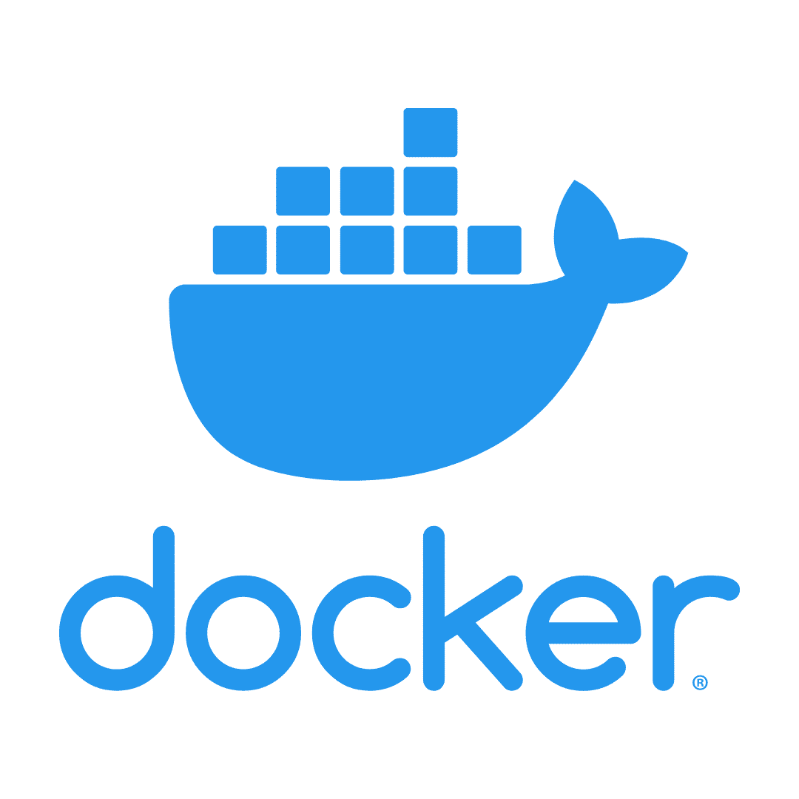
Docker
Containerizing your work
Dockerfiles
Sometimes you will be able to leverage an officially maintained image built around your framework of choice that will have most dependencies preinstalled.
Other times you will have to create a Dockerfile from scratch.

Slide 44
Enhancing, Selling, & Delivering
Promoting & Selling your Work
Your models have been designed specifically to meet your client’s needs.
Your demo or UI has been designed to best showcase interactive features and use cases for the model and data you’ve dealt with for the client. (From visualizations to model outputs and interpretation.)
By this point, your customer should be all in.
Notes:
Remember, it is highly unlikely that you will be responsible for the entire process from end-to-end. Your focus is on developing models and outputs that are usable and accurate, and using the appropriate tools to accomplish that goal.

Slide 45
Enhancing, Selling, & Delivering
Promote your own work!
Champion your own models!
Defend your model’s uses and applications -- think broadly in scope.
Always look for ways to apply (recycle!) efforts you’ve made to different problems.
Maintain Code & Repo organization! Headers, Comments, Markdown Cells should be used for Notes/Explanations.
The magic of the “Black Box” has worn off; clients want to know what’s going on inside the models, even if they don’t quite understand.
Most clients will not buy into concepts they cannot grasp.
Develop ways of explaining how your model functions in non-technical terms. Keep it simple, but don’t talk down.
Explaining technical work in a manner the client can follow is crucial to getting their full support for future development.
Easy-to-Follow visualizations go a very long way to both explaining your model’s purpose and function and defending your efforts applicability.
Notes:
But don’t exaggerate the usefulness of your model. Using layman’s terms is important -- but be way of generalizing the work to the point that others think it does something that it cannot.

Slide 46
Requested Topics!
Any topics that we didn’t cover that you’d like an introduction to?
A review or more in depth look of any of the previous topics?

Slide 47
Options/ideas for Remaining Course Time
Spinning-Up Basic NLP Models/Tasks with AdaptNLP
Exploring Data & Running Models in Google Colab
MLOps topics
RegEx Practice on Various Strings
More Visualization Practice!

Slide 48
Thank You!

